Slide 1
2024 Updates

Slide 2
AWS Teams
AWS Abuse Team
Sending email spam
It is located under the AWS Personal Health Dashboard
AWS Technical Account Manager (TAM)
Customer Onboarding and Relationship Building
Technical Support and Issue Resolution
AWS Support
Developer
Spamming online forums or other websites
Hosting a site advertised in spam
Excessive web crawling
Intrusion attempts (e.g., SSH or FTP)
Exploit attacks (e.g., SQL injections)
Hosting unlicensed copyright-protected material
Phishing website
Website hosting viruses/malware
Credit card fraud
Open proxy
Port scanning
IRC botnet activity
Proactive Monitoring and Optimization
Project Management and Escalation Handling
Knowledge Sharing and Training
This support Is not free and comes with Developer, Business and Enterprise support plans
This service is free
Business
Enterprise On-Ramp
Enterprise
Basic
AWS Trusted Adviser
AWS Health
AWS 24x7 community services like re:Post, documentations, whitepapers, etc.
Notes:
AWS Abuse team: AWS Abuse addresses many different types of potentially abusive activity such as phishing, malware, spam, and denial of service (DoS)/ distributed denial of service (DDoS) incidents. When abuse is reported, we alert customers so they can take the remediation action that is necessary. Customers want to build automation for handling abuse events and the actions to remediate them.
AWS Technical Account Manager (TAM) : A TAM is a technical professional who serves as a trusted advisor to customers, ensuring their seamless experience with a product or service
AWS Support please visit https://aws.amazon.com/premiumsupport/plans/

Slide 3
AWS Support Team
Lets visit the Support website and see the important differences
https://aws.amazon.com/premiumsupport/plans/
Developer and Business plan doesn’t get
TAM support
Billing Assistance
AWS Managed Services

Slide 4
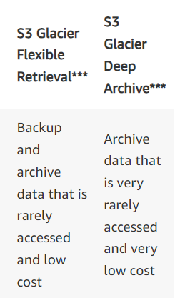
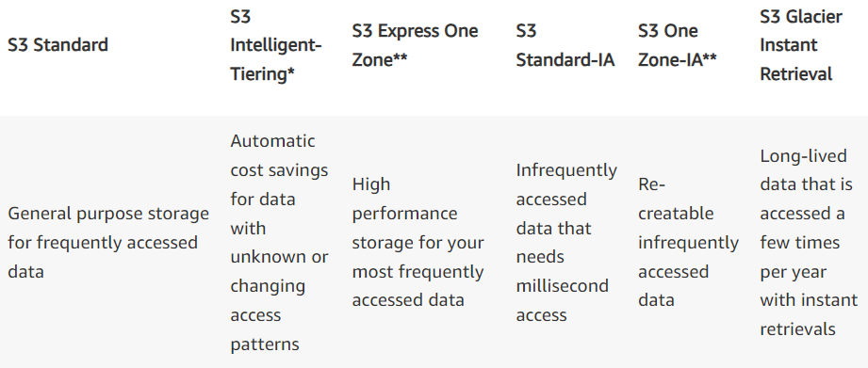
AWS S3 Storage Updates

Slide 5
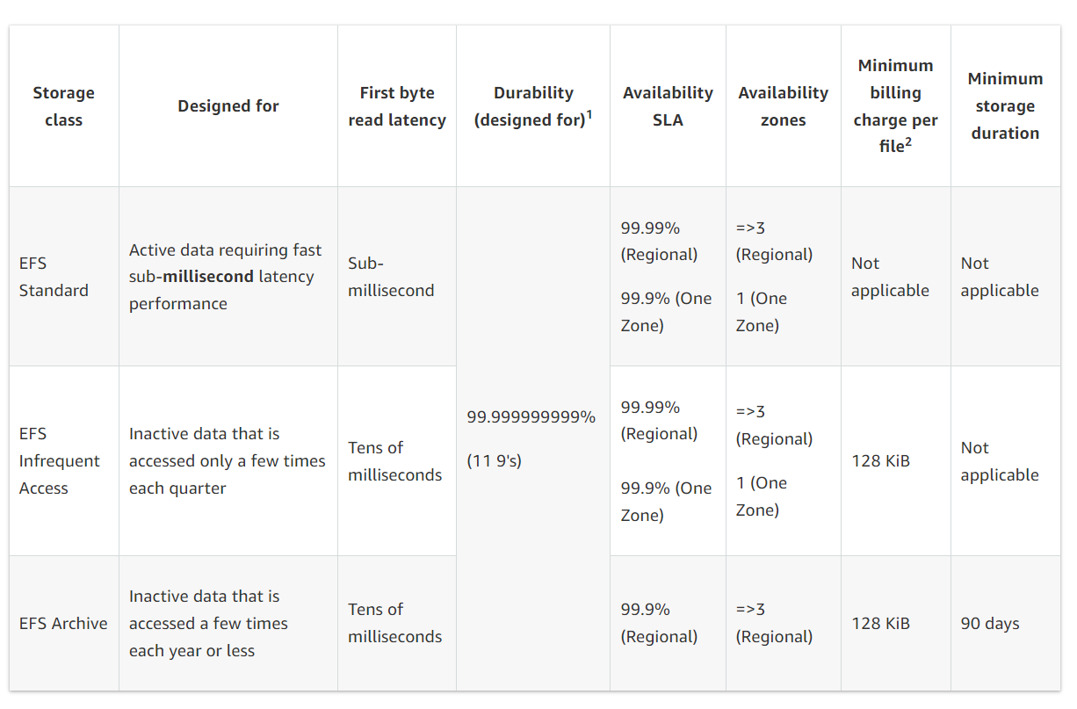
AWS EFS Storage Updates

Slide 6
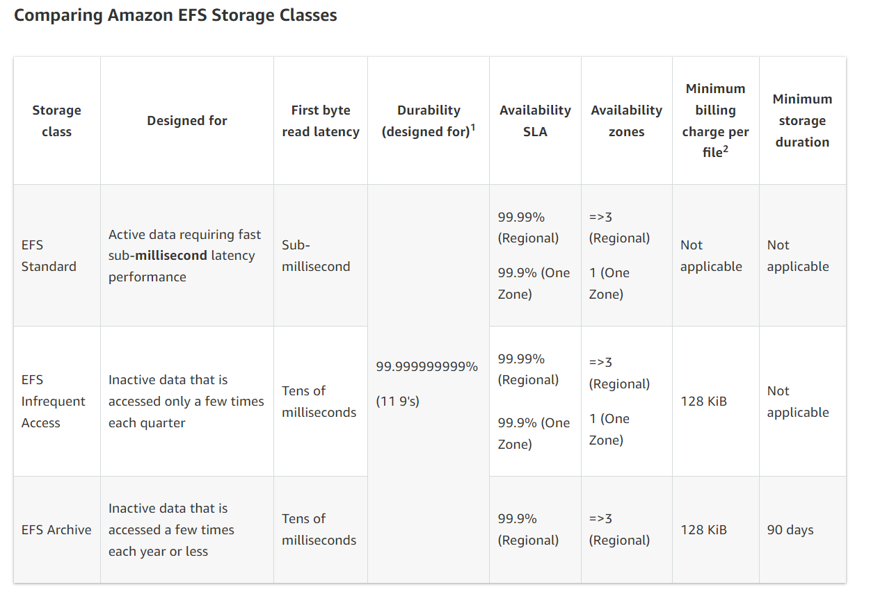
AWS EFS Storage Classes

